Slide 1
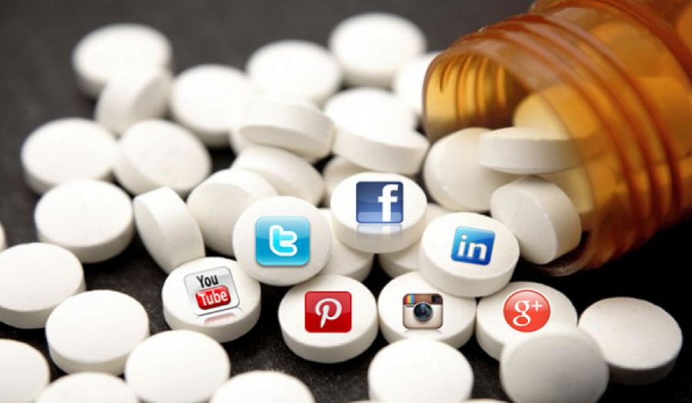
Social Media Detox
W241 Final Project
2019 April 17th
Authors: Kuangwei Huang, Shangyu Lv, Stanley Ye
Notes:
[STANLEY]
Hello Everyone, my name is Stanley, and my partners are Kuangwei and Shangyun.
Today, we would like to present our experiment, titled “Social Media Detox.”
7
---
Citation
Pic (apps): https://cnet3.cbsistatic.com/img/qACHj5CTcRGLTRZEKo1GY9exZD8=/1600x900/2018/12/03/e3d8b4f9-0daf-4119-9c65-9e7f72d725d2/social-media-apps.jpg

Slide 2
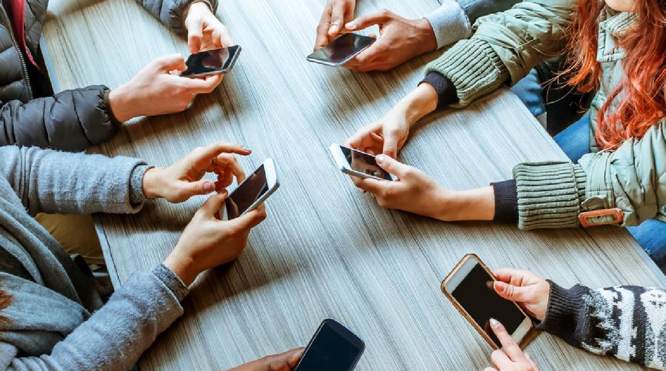
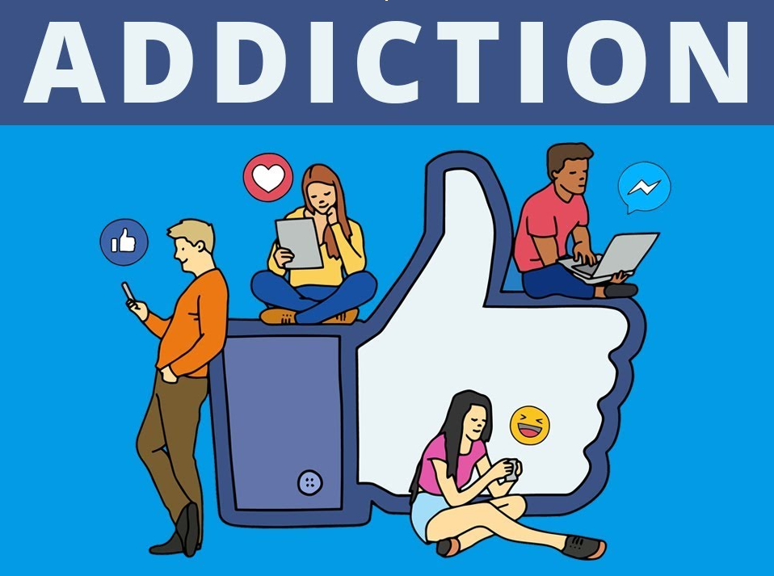

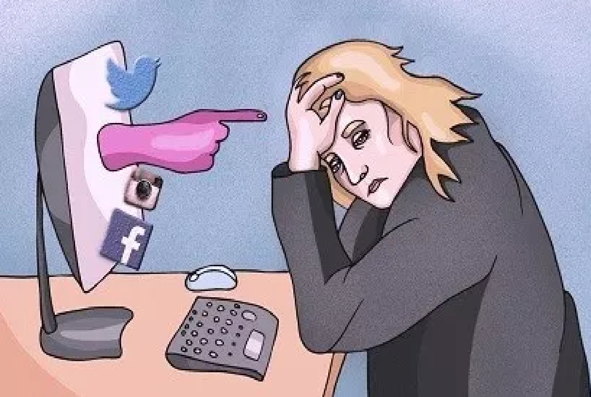
Motivation
Notes:
[STANLEY]
Before starting this project, we had this general impression that social media can be
[T] addictive, where users are constantly checking their phones for updates.
We also had the impression that social media can be a drain on emotional health if it replaced
[T] healthy in-person interactions
[T] Or, if it I resulted in cyber-bullying.
14
---
Citation
Pic (Addiction): https://i.ytimg.com/vi/SgOh2KCXZ_8/maxresdefault.jpg
Pic (Cell Phones): https://www.hindustantimes.com/rf/image_size_960x540/HT/p2/2018/03/12/Pictures/_ad86e356-25e1-11e8-a8dd-98cd3615fcfa.jpg
Pic (In-Person Conversation): https://www.foodzaps.com/v2/wp-content/uploads/2016/07/iStock_000039464956Medium.jpg
Pic (Social Media Bullying): https://encrypted-tbn0.gstatic.com/images?q=tbn:ANd9GcTidPe3jwy_riXzF4de-vnuYgvX4kRMk2XITRc0eA32zWWrOMlLYg

Slide 3
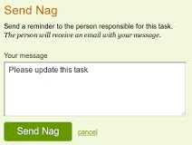
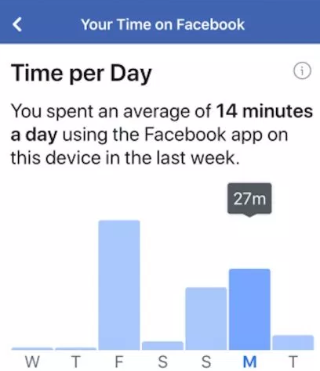
Research Questions
How do email (nag) reminders affect screen time usage of social media apps?
Notes:
[STANLEY]
Hence, we were curious to find out how effective
[T] email reminders woud be at affecting, and hopefully reducing,
[T] screen time usage of social media apps.
Our hypothesis was that email remainders can indeed reduce usage of social media apps.
11
---
Citation
Pic (Send Nag): https://www.google.com/imgres?imgurl=http%3A%2F%2Fwww.taskanyone.com%2Fhelp_images%2FNag.png&imgrefurl=http%3A%2F%2Fwww.taskanyone.com%2Fdocs.html&docid=3zt5AkB-2H4_OM&tbnid=gyrvu0OUp2uJbM%3A&vet=10ahUKEwigoYWV1dLhAhXHwFQKHc4IBW8QMwhCKAIwAg..i&w=474&h=379&safe=off&bih=646&biw=1280&q=email%20nag&ved=0ahUKEwigoYWV1dLhAhXHwFQKHc4IBW8QMwhCKAIwAg&iact=mrc&uact=8
Pic (Time on Facebook): https://www.google.com/imgres?imgurl=https%3A%2F%2F9to5mac.com%2Fwp-content%2Fuploads%2Fsites%2F6%2F2018%2F11%2FScreen-Shot-2018-11-20-at-7.54.02-PM.jpeg%3Fquality%3D82%26strip%3Dall%26w%3D1600&imgrefurl=https%3A%2F%2F9to5mac.com%2F2018%2F11%2F20%2Fyour-time-on-facebook-rollout%2F&docid=7sWvqGzDoJeMOM&tbnid=ITzPC-w7ALMDvM%3A&vet=10ahUKEwjcnt3z1NLhAhWCxZ8KHQybAGcQMwhBKAEwAQ..i&w=1600&h=900&safe=off&bih=646&biw=1280&q=screen%20time%20facebook&ved=0ahUKEwjcnt3z1NLhAhWCxZ8KHQybAGcQMwhBKAEwAQ&iact=mrc&uact=8

Slide 4
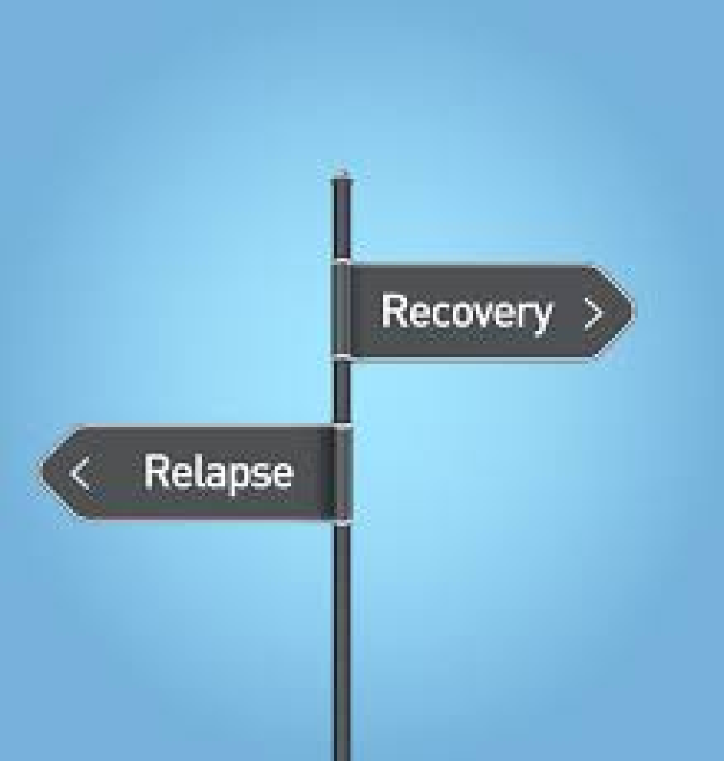
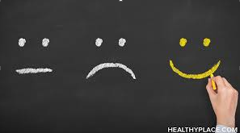
Research Questions (2)
Can treatment-induced changes to screen time be sustained post-treatment?
How do changes to screen time influence emotional state?
Notes:
[STANLEY]
In addition, we wanted to study if treatment-induced behavior changes would be sustained after the email reminders had stopped.
[T] And lastly, we wanted to check for correlation between screen time usage changes and emotional states.
10
---
Citation
Pic (Relapse-Recovery): https://www.google.com/imgres?imgurl=https%3A%2F%2Fwww.northpointrecovery.com%2Fblog%2Fwp-content%2Fuploads%2F2015%2F05%2FDollarphotoclub_77076347.jpg&imgrefurl=https%3A%2F%2Fwww.northpointrecovery.com%2Fblog%2Fwhy-does-relapse-happen%2F&docid=ZtHimcGQsFP0iM&tbnid=6yRNyopDSWNkzM%3A&vet=10ahUKEwj4gaiN49LhAhVFM3wKHUMbDfoQMwhqKAAwAA..i&w=3300&h=3465&safe=off&bih=646&biw=1280&q=relapse&ved=0ahUKEwj4gaiN49LhAhVFM3wKHUMbDfoQMwhqKAAwAA&iact=mrc&uact=8
Pic (Chalkboard): https://www.google.com/imgres?imgurl=https%3A%2F%2Fwww.healthyplace.com%2Fsites%2Fdefault%2Ffiles%2F2018-05%2Fwhat-mean-emotionally-healthy-healthyplace.jpg&imgrefurl=https%3A%2F%2Fwww.healthyplace.com%2Fself-help%2Fself-help-information%2Fwhat-does-it-mean-be-emotionally-healthy&docid=8RE2L6bIdTMVxM&tbnid=HohuL3ITqqWpEM%3A&vet=10ahUKEwil0-Kr5NLhAhUijlQKHRqcDNUQMwhrKAEwAQ..i&w=800&h=450&safe=off&bih=646&biw=1280&q=emotional%20health&ved=0ahUKEwil0-Kr5NLhAhUijlQKHRqcDNUQMwhrKAEwAQ&iact=mrc&uact=8

Slide 5
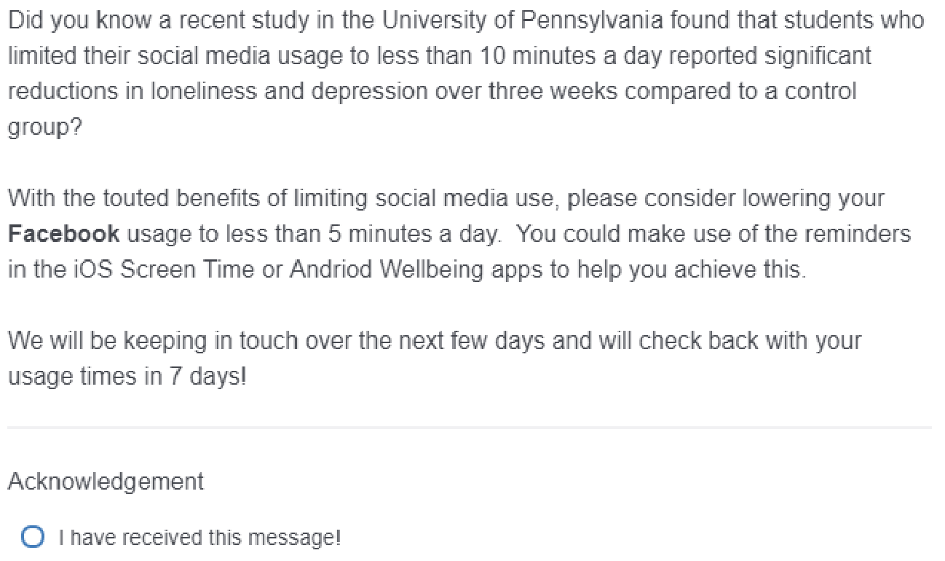
Treatment: Qualtrics - Day #1
Notes:
[STANLEY]
On Day 1 of treatment, we sent emails with links to the following Qualtrics message.
[T] First, we touted the emotional health benefits of curbing social media usage.
[T] Then, we requested subjects to limit their screen time of a assigned social media app to less than 5 minutes per day.
[T] Lastly, we requested subjects to acknowledge receipt of the Qualtrics message.
20
---
Citation

Slide 6
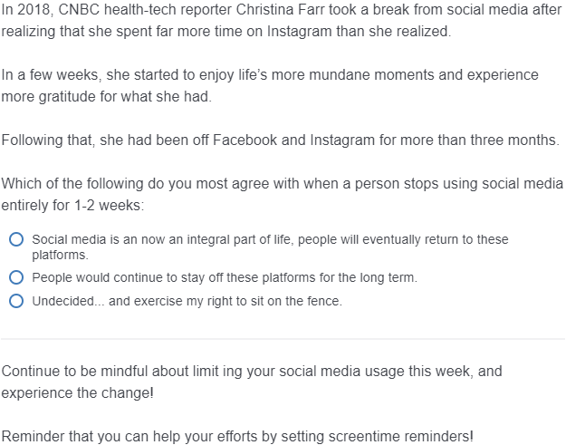
Treatment: Qualtrics - Days #2-6
Anecdote
Question
Reminder
Notes:
[STANLEY]
On Days 2-6 of treatment, we sent messages of this format.
[T] First, we provided an inspiring anecdote, promoting the upside of social media detox.
[T] Then, we asked a question to get the subjects thinking about their social media usage.
[T] Finally, we concluded by gently reminding subjects to continue limiting their usage of social media apps.
17
---
Citation

Slide 7
Participants
Recruited social media app users:
I School-ers
Family, friends, friends of friends
Incentivized with $10 reward
Nearly 200 people tried to participate by visiting pre-experiment survey
Only 50 people successfully completed pre-experiment survey
Unfamiliarity with Screen Time and Wellbeing app usage trackers
Too long to complete:
2 minutes per average submission
6 minutes per successful submission
Notes:
[STANLEY]
For our experiment,
[T] we recruited users of social media apps
[T] from our I School classmates
[T] from family and friends
[T] while offering a small reward as an incentive.
[T] Even though we did get 200 people to visit our pre-experiment survey,
[T] Only 50 or so submissions were successfully completed.
[T] Mainly due to lack of familiarity and/or availability of app usage trackers
[T] And due to our sign-up form being too time-consuming,
where it took
[T] 2 minutes on average
[T] and over 6 minutes for each successful submission
25
---
Citation

Slide 8
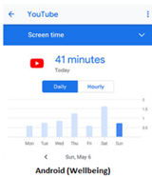
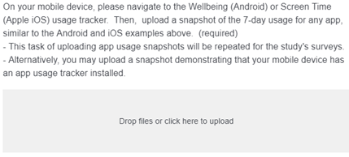
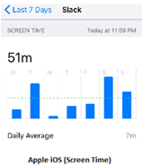
Pre-Experiment Survey
Collected demographic info: age, gender, country
Request for screen time snapshots served as a pilot study
Ensured participants had app usage trackers installed
Verified participants could take and upload screenshots to Qualtrics
Notes:
[STANLEY]
In our pre-experiment survey,
[T] We collected demographic info
[T] In addition, we requested screen time snapshots, shown here, which served the dual-purpose of being a pilot study for us,
[T] since this ensured that folks had app usage trackers installed on their phones
and that they knew how to take and upload screenshots to Qualtrics.
15
---
Citation

Slide 9
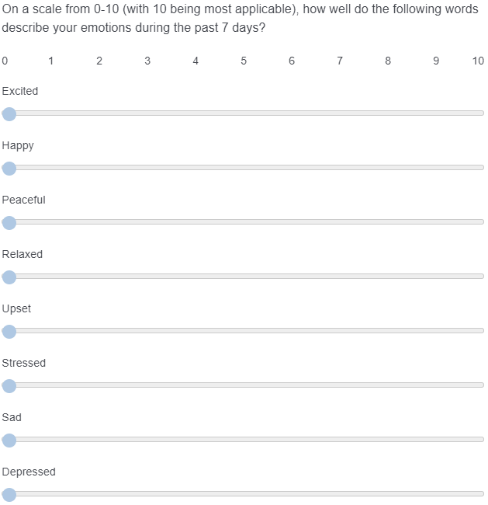
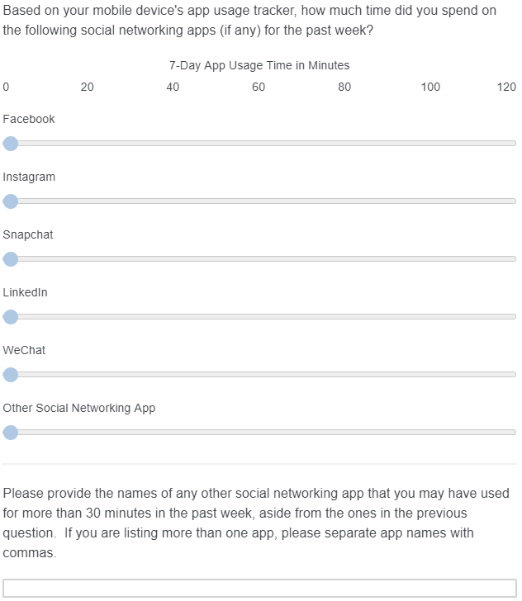
Pre-Experiment Survey (2)
Notes:
[STANLEY]
Our pre-experiment survey also collected 2 other pieces of info:
[T] One was the emotional states of volunteers
[T] as well as the specific social media apps that they used.
Now, I will turn it over to my partner, Kuangwei.
9
---
Citation

Slide 10



ROXO Design
Grouping by Highest App Usage
Pre-Experiment
Survey
Randomization *
Measurement
Treatment
Treatment
Measurement
Measurement
R
R
O
O
X
X
O
O
O
O
R
R
O
O
X
X
O
O
O
O
O
* :
Randomization was performed with further blocking on:
Gender
Usage
R
R
O
O
X
X
O
O
O
O
Day 1
Day 2-6
Day 7
Day 14
Notes:
[KUANGWEI]
Thank you Stanley, I will continue to talk about the experimental design and this is the laid out in ROXO grammar.
From the pre-experiment survey, we collected:
- sufficient demographic information, as well as
- identified the top three social media applications used by our potential participants. Facebook, Instagram and WeChat.
We then further randomized each App group with blocking on
Gender and
Usage time, with high usage time being the participants who self-report using their app more than 120mins over 7 days.
Randomization was based on 60-70% treatment probability in each of the 12 sub-blocks.
The baseline measurement was then taken in the Day 1 survey sent out to all 47 participants and those that were assigned to treatment received a Day 1 survey with an additional prompt encouraging them to limit their social media usage.
Subsequent Days 2 – 6, treatment subjects were send daily survey messages to continually remind them.
1st milestone measurements on their screen time usage and their emotional states were taken at Day 7.
A period on radio silence is enforced for another 6 days, and a final screen time usage and their emotional states were taken at Day 14.

Slide 11
Outcome Measure #1
Daily screen time of social media app
Notes:
[KUANGWEI]
The first outcome measure is the daily usage for each subject’s assigned social media app.
For the experiment, this collected using the Screen Time snapshots from subjects which were uploaded into Qualtrics.

Slide 12
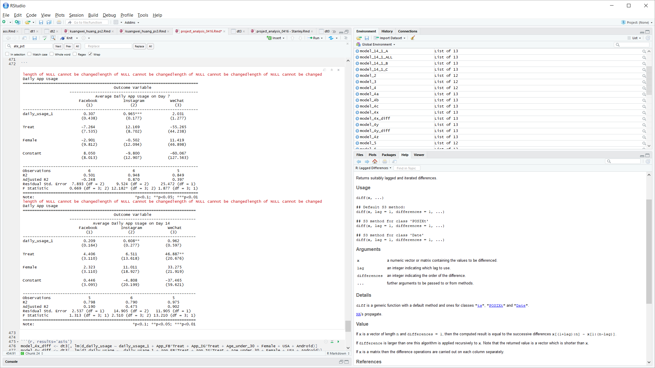
Average Daily App Usage
No major statistically significant results from Treatment in most cases
Treatment effect increases usage of WeChat 1 week after treatment is statistically significant
Notes:
[KUANGWEI]
We performed a linear regression on 2 outcomes:
Average Daily App Usage on Day 7
Average Daily App Usage on Day 14
No major statistically significant results from Treatment in most cases
Treatment effect increases usage of WeChat 1 week after treatment is statistically significant which is not very believable

Slide 13
Emotional State - Outcome Measure #2
Do the Participants’ Emotional Status Affected by the Treatment?
Circumplex Model of Mood Measurement
Activation
Mood | Activation | Pleasant
Excited | 4 | 3
Happy | 3 | 4
Peaceful | 2 | 4
Relaxed | 1 | 3
Upset | 3 | 1
Stressed | 4 | 2
Sad | 2 | 1
Depressed | 1 | 2
“stressed”
4
“excited”
“upset”
3
“happy”
Unpleasant
1
2
3
4
Pleasant
“sad”
2
“peaceful”
“depressed”
1
“relaxed”
Deactivation
Notes:
[SHANGYUN]
- Another motivation of the study has to do with many reporting that reducing social media usage make people happier
Measure before, during and after the treatment
Mood Measurement is not standardized
Some involve a lengthy questionnaire(like Ryff’s Psychological Well Being Scale) – not complete the survey
Too specific to certain emotional state(like loneliness scale or self-esteem scale) .
After some exploration, we found circumplex model which map all emotional state or mood into two axis - activation and pleasant.
Each word of mood can fall into one of the four quadrants in the system and quantify its weight on the axis.
Benefit: scaling mood to two axis effectively simplify the potential outcome to two values which make the analysis easier.
Do different words means differently to different people? They certainly could, that’s one of the reason the emotional measurement is not yet standardized. Some people even argue people can feel happy and sad at the same time. we will leave these to psychologist to figure out. Because we use the same method across the experiment, the comparison still reveal the change of the emotion.

Slide 14
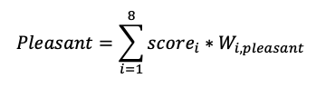
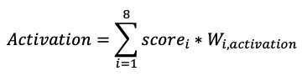
Emotional State - Outcome Measure #2
Implementation
One question in Survey
Conversion
4 3
3 4
2 4
1 3
3 1
4 2
2 1
1 2
Notes:
[SHANGYUN]
Another reason for us to choose circumplex model of mood is its simplicity on implementation. During the study we alway keep in mind that the survey shouldn’t be too long and mood measurement justify such concern. But with Circumplex, we reduce the measurement to just one question. Using eight words(two in each quadrant) instead of one or two for the measurement of activation and pleasant give more opportunity for the participants to accurately record their mood.
The total value of activation and pleasant is the weighted sum of all the scores given by the participant.

Slide 15
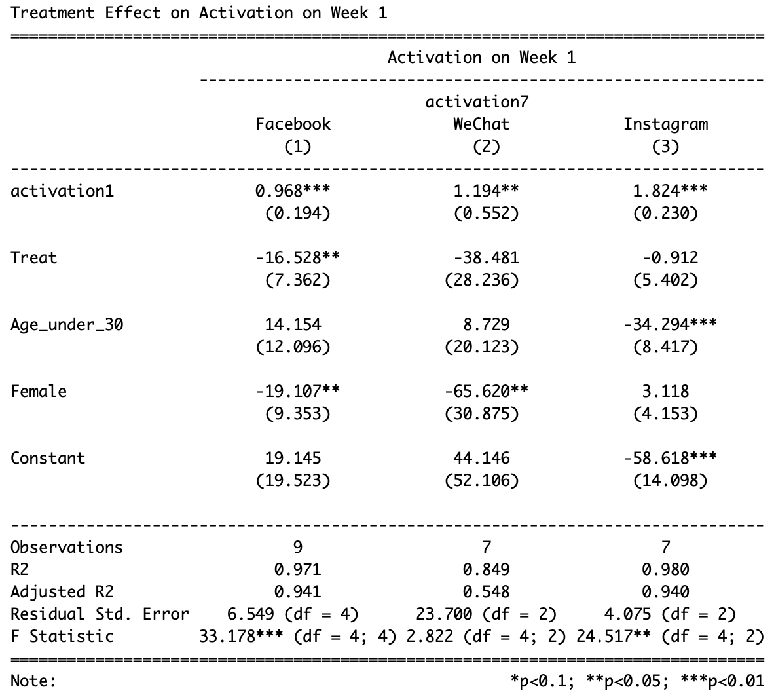
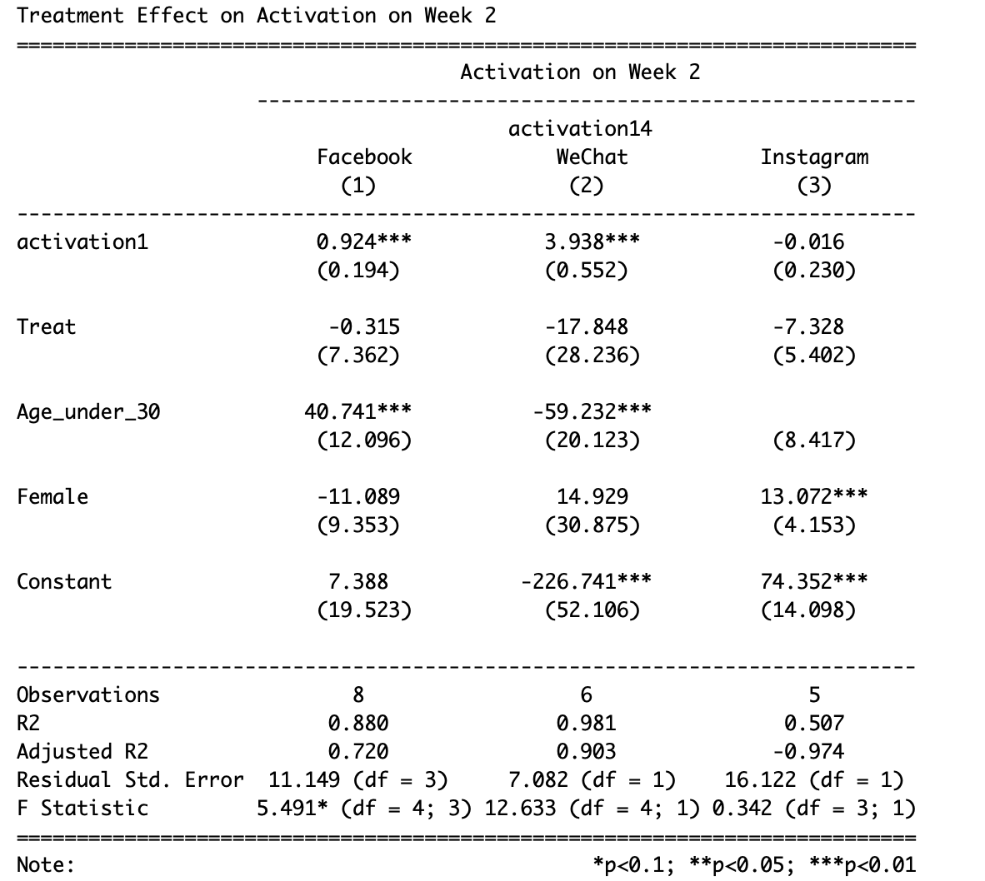
Activation
Treatment Reduce Activation during and after the treatment,
Some treatment effect is not significant
Notes:
[SHANGYUN]

Slide 16
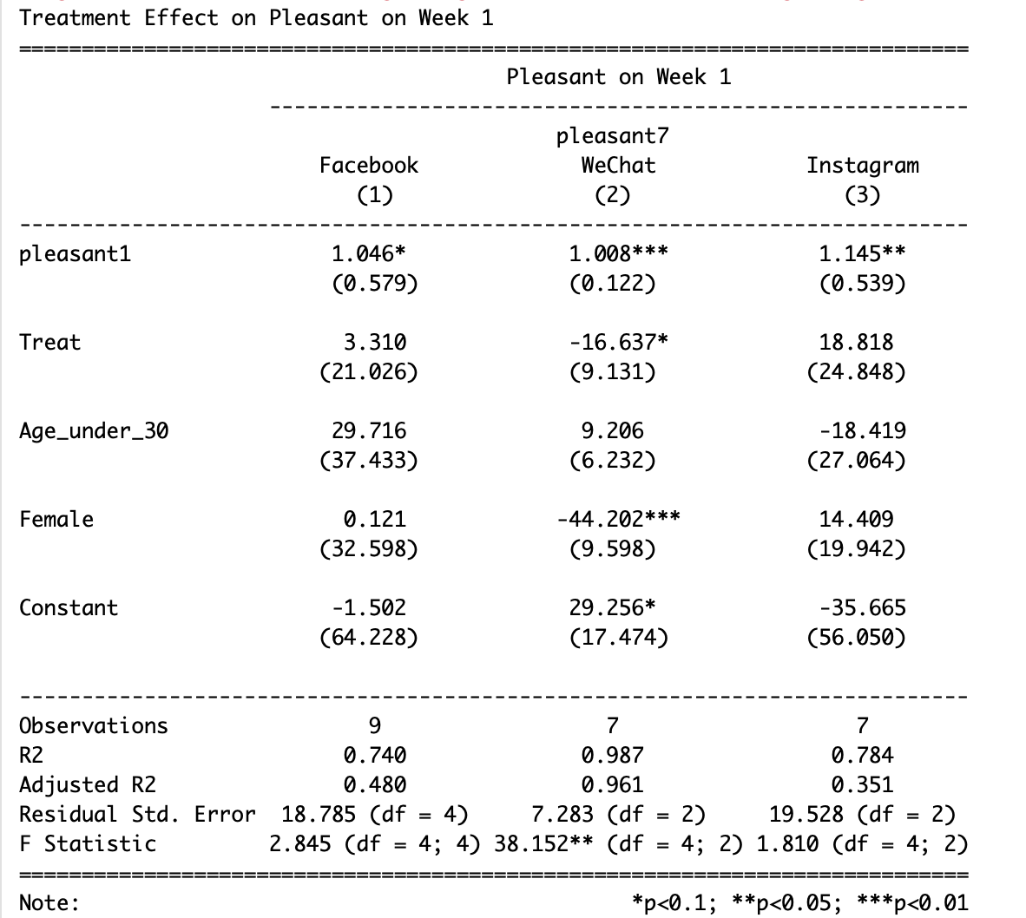
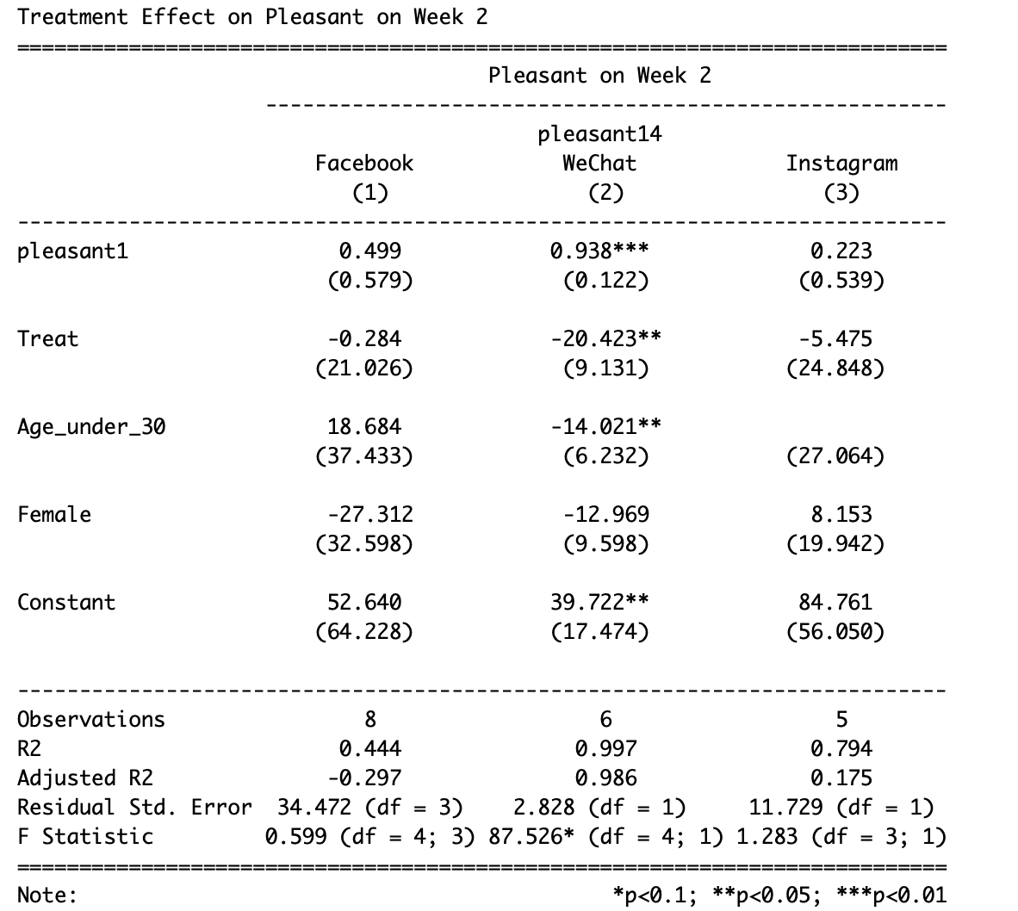
Pleasant
Treatment increase pleasant for Facebook and Instagram during the treatment, reduce pleasant for WeChat
People in the treatment group are less pleasant after the treatment
Some treatment effect is not significant
Notes:
[SHANGYUN]

Slide 17
Open Questions/Concerns
How can we better motivate subjects to abstain for 1 week from using their favorite social media app?
How can we effectively measure the long-term effects of our treatment (i.e., 1 week of reminder emails)?
How could we have made it easier for subjects to report their screen time usage, besides asking for Screen Time snapshots?
Notes:
[STANLEY]
Here are some questions that we have for the class, on improving our experiment design.
17
---

Slide 18
Thank you!

Slide 19
Backup

Slide 20
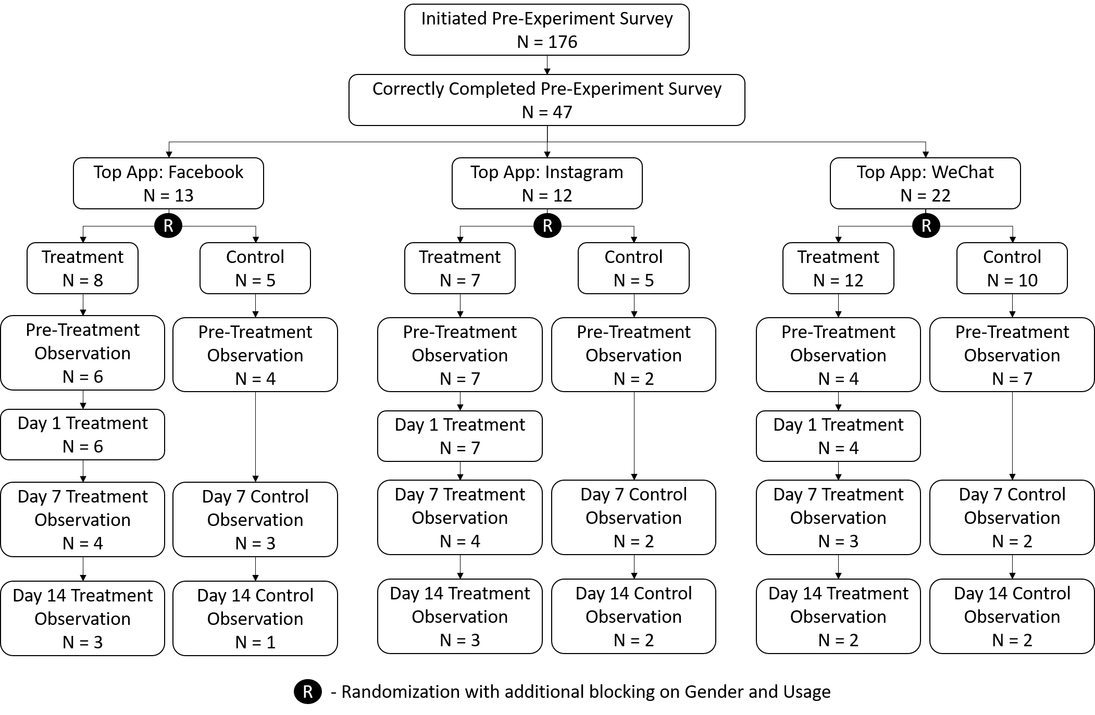
Attrition
Notes:
Citation

Slide 21
Conclusions on Treatment Effect
During the Treatment - Week 1
“+”: increase; “-”: decrease
“*”: Treatment Effect Significance
App Name | Daily Usage | Activation | Pleasant
Facebook | + | - | +
Instagram | + | + | +
WeChat | - | - | +
Notes:
Do the message serves as a reminder than advice?

Slide 22
Conclusions on Treatment Effect
After the Treatment - Week 2
“+”: increase; “-”: decrease
“*”: Treatment Effect Significance
App Name | Daily Usage | Activation | Pleasant
Facebook | +(**) | +(*) | +
Instagram | +(**) | + | +
WeChat | +(***) | -(*) | -
Notes:
Do the message serves as a reminder than advice?

Slide 23
Outline
What is your research question?
Why is an experiment necessary?
What is the specific hypothesis that you’re testing that is implied by theory or your question?
What direction do you expect your outcomes to move as a consequence of treatment?
What is your treatment? Be specific. Show pictures of it, show the language that you used, etc. For me or the class to understand what you did, we need to understand what you did!
Explain who/what your measurement units are. People? From where? Robots? What type?
How did you randomize and did it work?
Draw out using the ROXO grammar your experiment design, describe the comparisons that you’re going to make that tell you something causal. Call this a RDD, or a D-n-D, or a within subjects or a between subjects comparison.
Describe your outcome measures. What are they? How are they related to the concept that motivated this experiment? What are they distributed like?
Describe your analysis, results.
List the questions and concerns that you want your peers to help you puzzle through.
Notes:
[NOTES]

